Slide 1

ONLINE FOOD DELIVERY SYSTEM

Slide 2
TEAM MEMBERS
Pullimaddi Venkata Revanth
(TEAM LEAD)
Jayadhivyamani J
Niharika Das
Pooja Singh
Ankita Mishra
Najmunishaa D
Pasupuleti Divya
Dhiyaneshwaran X
Saravanakumar T
Satya Kartheek Devanaboina

Slide 3
ABSTRACT
In this project, we have created a Java Micro-services applications called Online FoodappAdmin and FoodappCustomer.
We used spring-boot for the backend and MySQL for the database and POSTMAN for testing.
Each microservices is responsible for a specific task, such as Admin, Carts, Products , Customers and Purchase.
Java, a versatile and widely adopted programming language, is utilized to implement these microservices , ensuring compatibility and performance. Additionally, containerization technologies such as Docker and tools like Kubernetes are employed for seamless deployment and scaling.

Slide 4
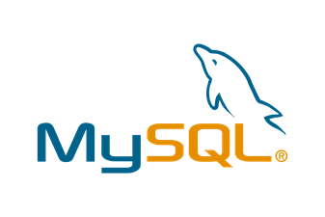


TOOLS & TECHNOLOGIES
Server Side: Spring Boot, Spring Data JPA
Back-end: MY SQL Database/
Server: Apache Tomcat 9.0
Testing : Postman.

Slide 5
SPRING BOOT
Spring Boot is an open-source Java-based framework that makes it easy to create stand-alone, production-grade Spring applications.
AutoConfiguration.
Starter dependencies
Spring Ecosystem Integration
Microservices Support
Monitoring and Actuator
Java-Based

Slide 6
MICROSERVICES
Java microservices refer to a software architecture approach in which an application is built as a collection of small, independent, and loosely coupled services, all written in Java.
Each microservices is responsible for a specific business capability or function and communicates with others over a network, often using lightweight protocols like HTTP or messaging systems.
Java microservices architecture is an approach to software development that emphasizes small, independently deployable services that communicate to provide a complete application.

Slide 7
BENEFITS OF MICROSERVICES
Some of the benefits of using Java microservices include:
Scalability
Agility
Resilience
Maintainability

Slide 8
FRAMEWORKS AND TOOLS
Some of the popular frameworks and tools for developing Java microservices:
Spring Boot
Netflix OSS
Kubernetes

Slide 9
MICROSERVICES ARCHITECTURES
Config Server
Eureka
Feign
Resilience and Retry
Sleuth and Zipkin

Slide 10
RABBIT MQ
RabbitMQ is the most widely deployed open source message broker.
RabbitMQ helps in scaling the application by deploying a message queuing mechanism in between the two applications.
It offers temporary storage for data preventing data loss.
RabbitMQ Queue takes messages from the publisher and sends them to the consumer.
latest RabbitMQ 3.12
docker run -it --rm --name rabbitmq -p 5672:5672 -p 15672:15672 rabbitmq:3.12-management

Slide 11
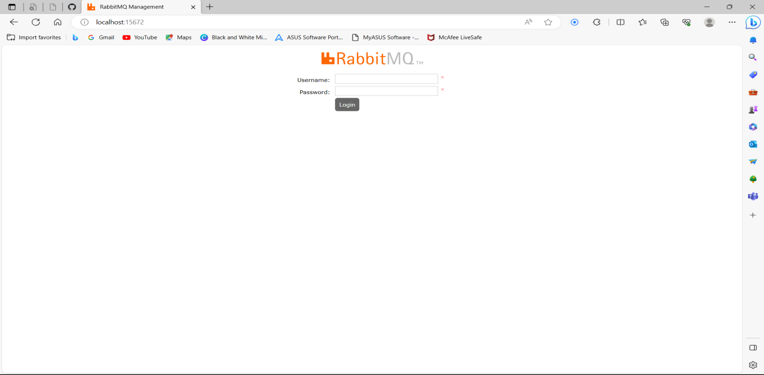
RABBIT MQ

Slide 12
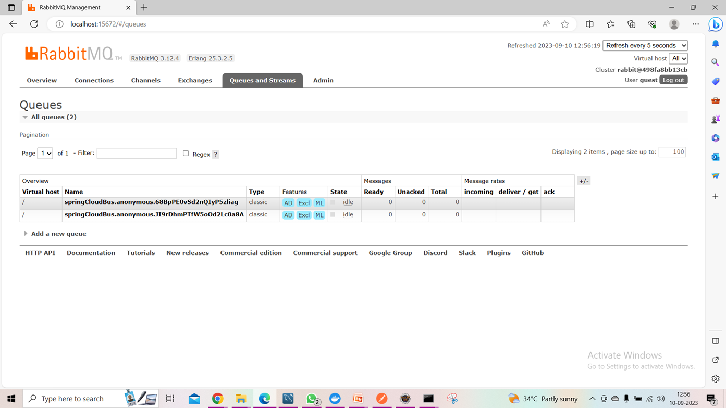
RABBIT MQ

Slide 13
CONFIG SERVER
A config server is a centralized repository for storing configuration data for microservices. This data can include things like database connection strings, API keys, and environment variables.
A "Config microservice" typically refers to a microservice or component within a microservices architecture that is responsible for managing and distributing configuration settings and parameters to other microservices and applications in the system.
The config servers also store Authentication configuration information such as Role-Based Access Control or internal authentication settings for the cluster.

Slide 14
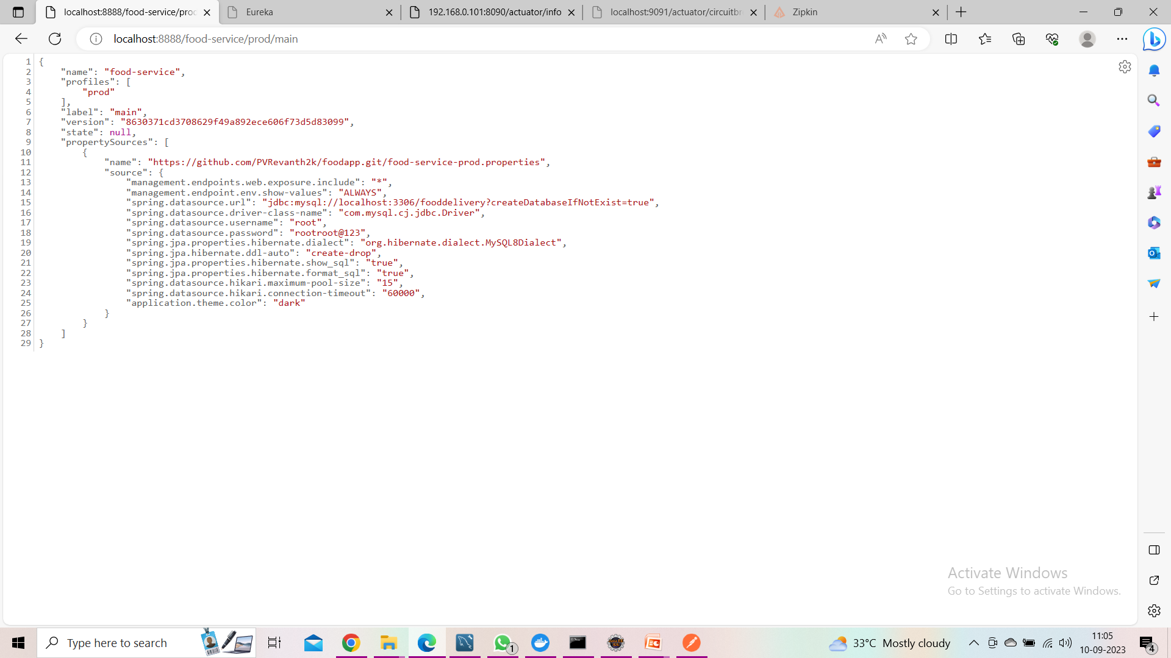
PROD MAIN

Slide 15
EUREKA
Netflix Eureka is a Java-based open source project that provides a RESTful interface for service discovery and registration.
Eureka helps to make microservices more resilient by providing a central registry of microservices. This means that if one microservice goes down, the other microservices can still find each other.
Eureka Server integrates with load balancing mechanisms such as Ribbon. This means that clients can query Eureka Server to retrieve a list of available service instances for a specific service.

Slide 16
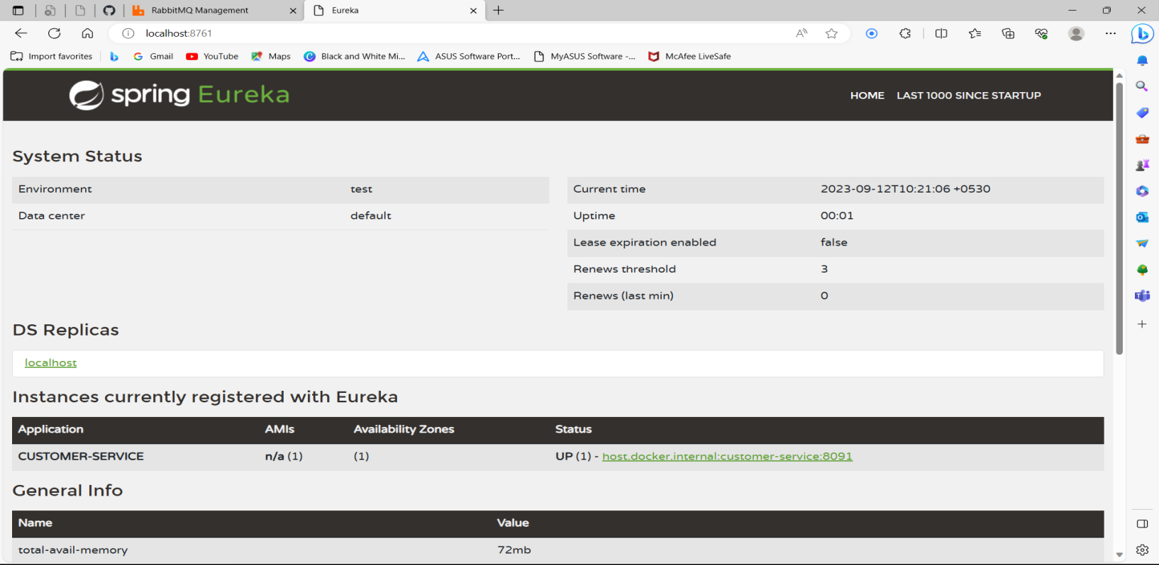
EUREKA SERVER

Slide 17
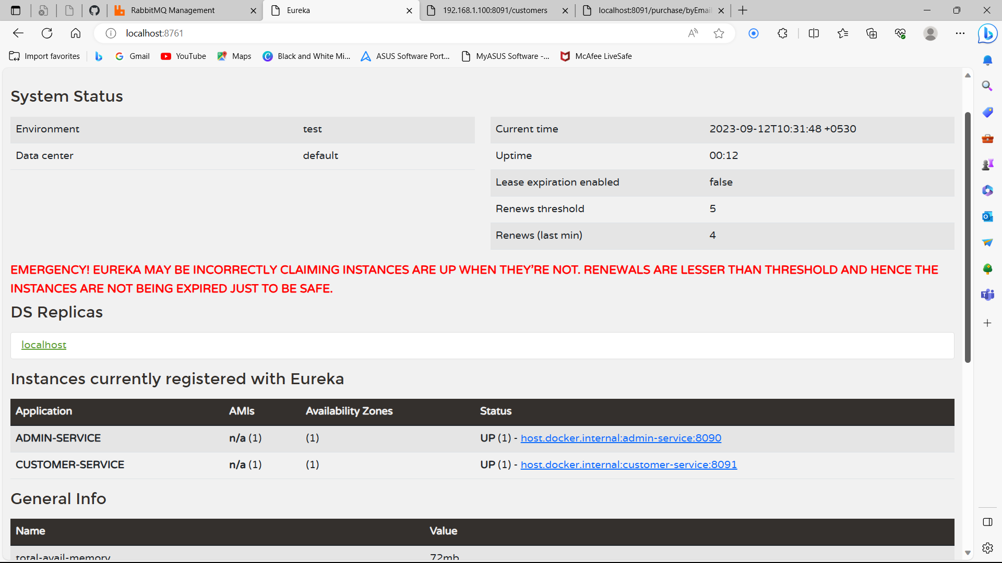
EUREKA SERVER

Slide 18
FEIGN
The Feign client is a declarative REST client that makes writing web clients easier. When using Feign, the developer has only to define the interfaces and annotate them accordingly.
Microservices use Feign clients to interact with other microservices' APIs or endpoints, making it easier to implement inter-service communication.
The @FeignClient annotation is a part of the Spring Cloud Netflix project and is used in Spring-based applications to simplify the process of making HTTP requests to other RESTful services, often within a microservices architecture.

Slide 19
Resilience and Retry
Resilience4j is a lightweight fault tolerance library that can be used to implement the retry pattern in microservices. It provides a number of features that can be used to configure the retry pattern, such as:
The maximum number of retries
The wait duration between retries
The exceptions that should be retried
The backoff algorithm
The @Retry annotation allows us to configure the retry pattern, such as the maximum number of retries and the wait duration between retries.

Slide 20
Sleuth and Zipkin
Sleuth is a library that helps to generate and propagate trace IDs across multiple services. Trace IDs are unique identifiers that can be used to correlate requests across multiple services.
Zipkin is a server that collects and stores trace data. It can be used to visualize and analyze trace data, helping you to identify performance bottlenecks and other problems in your microservices architecture.
Together, they offer a comprehensive solution for understanding and optimizing microservices-based applications.
To start the zipkin via docker, we need to run this command
docker run -d -p 9411:9411 openzipkin/zipkin

Slide 21
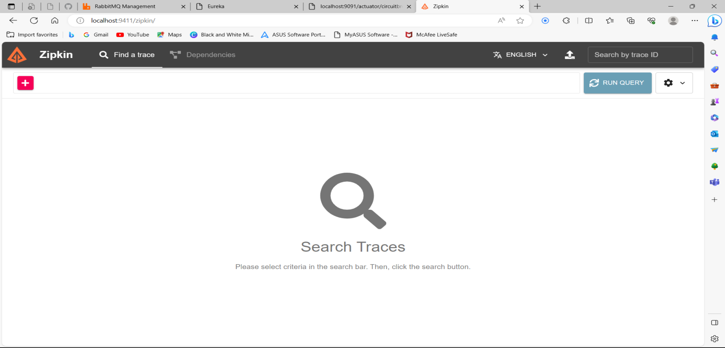
ZIPKINS

Slide 22
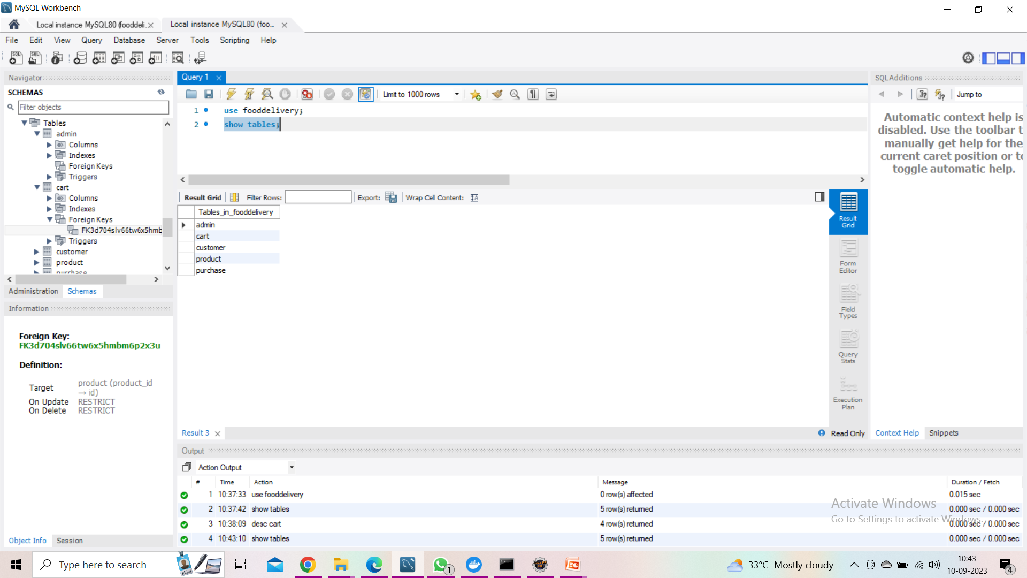
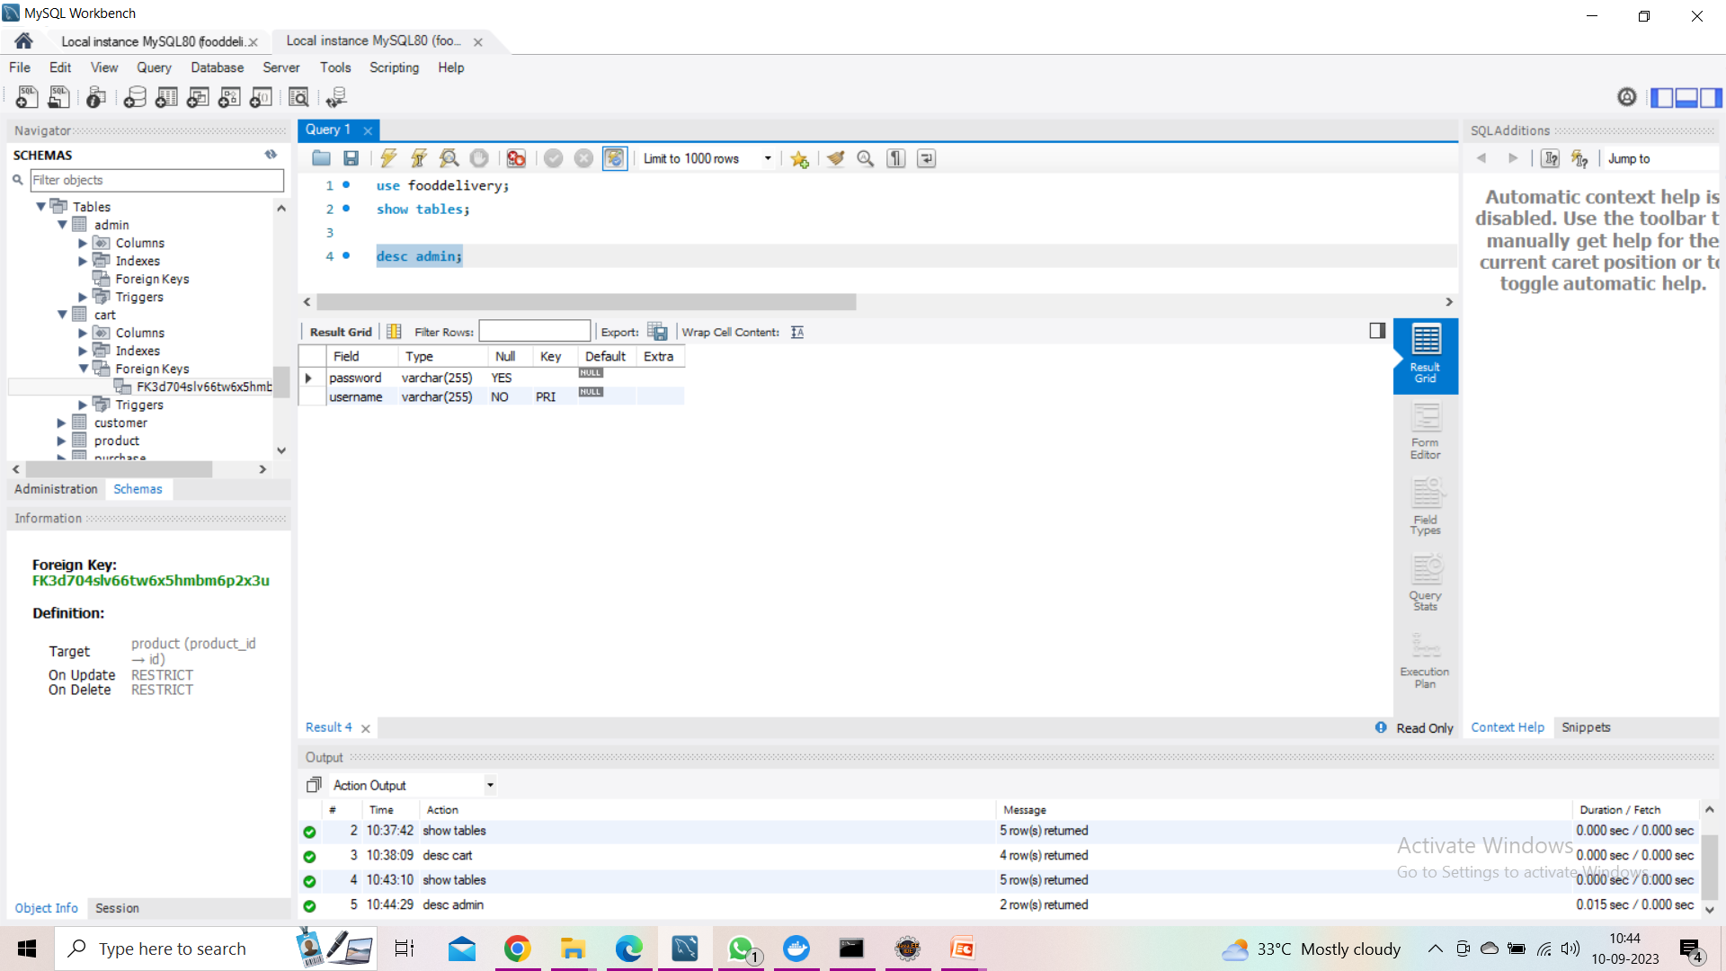
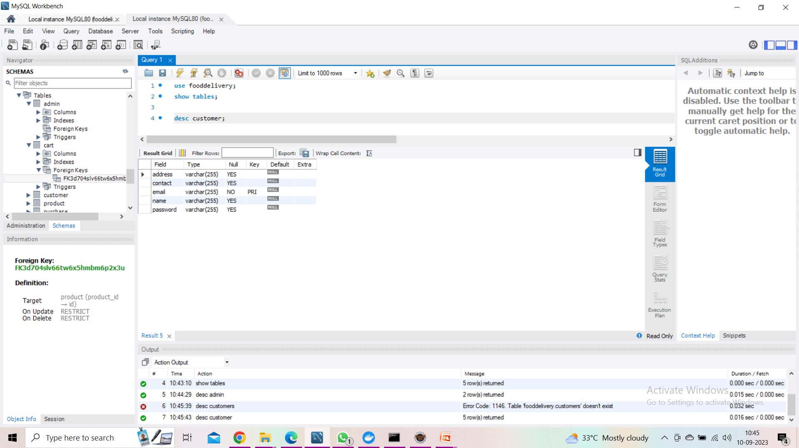
DATABASE

Slide 23
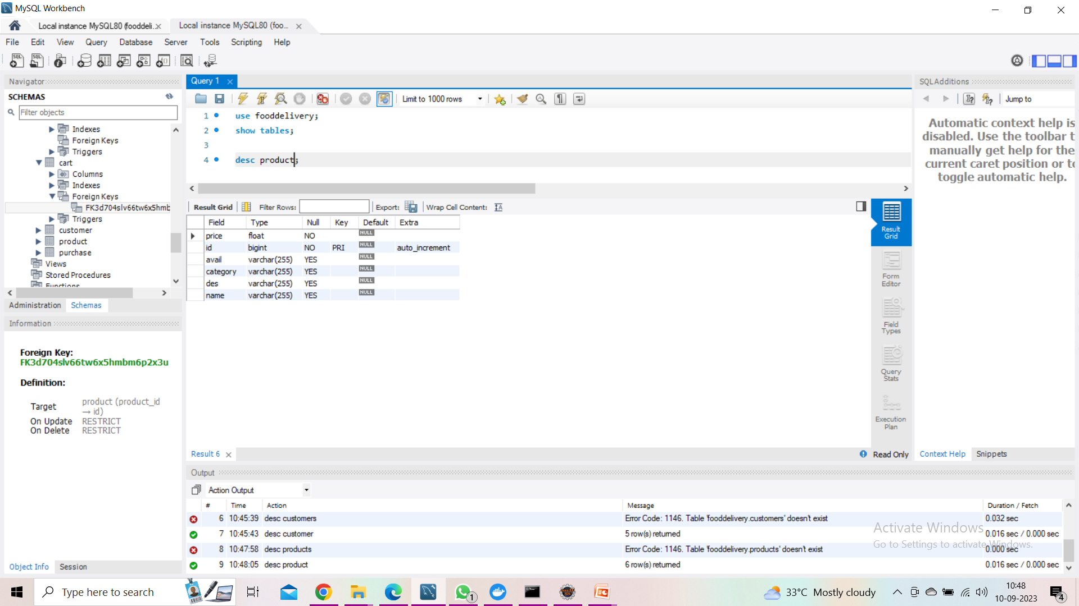
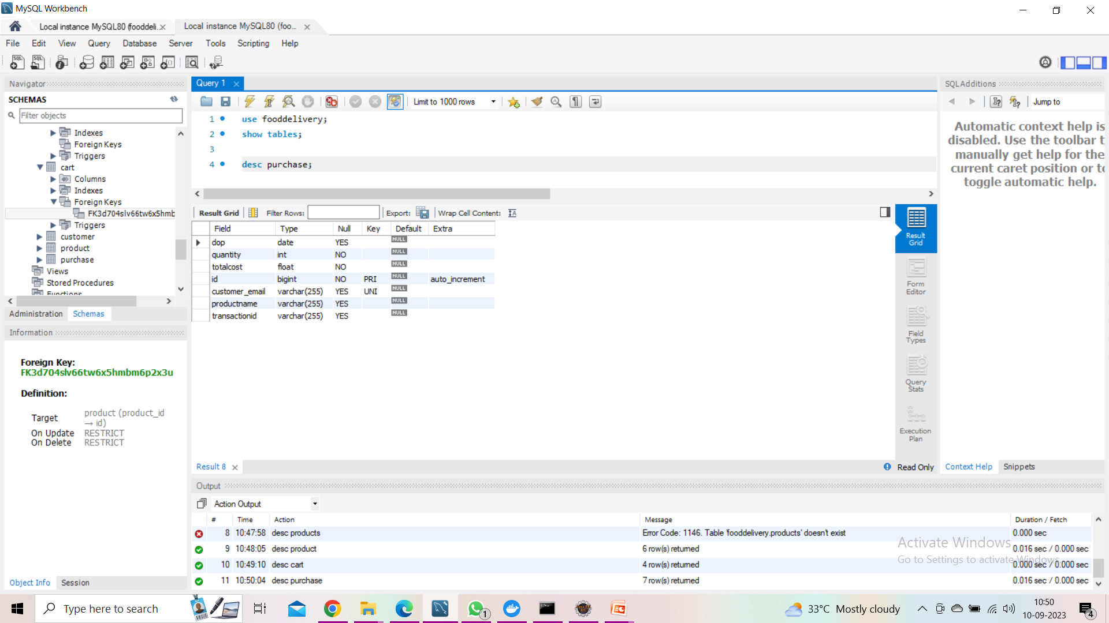
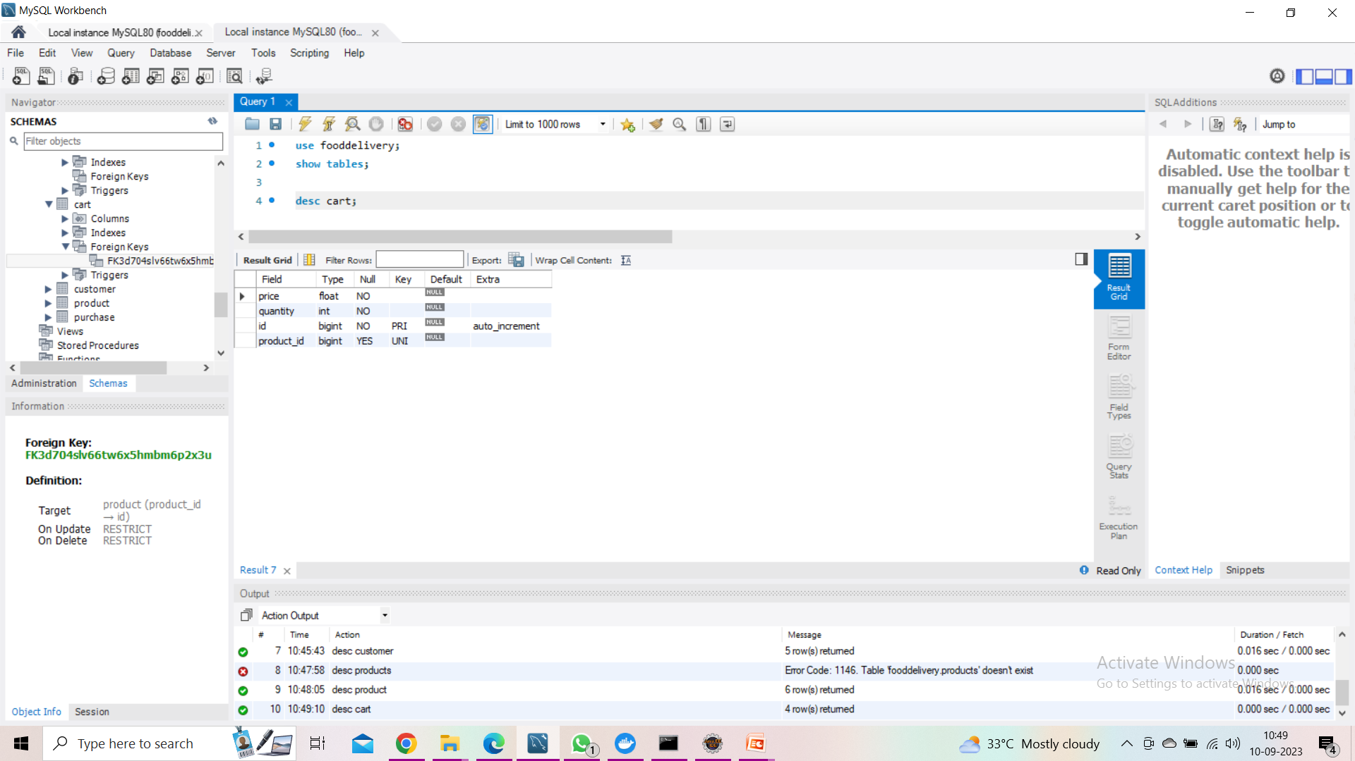
DATABASE

Slide 24
POSTMAN TESTING
Postman is an application used for API testing. It is an HTTP client that tests HTTP requests, utilizing a graphical user interface, through which we obtain different types of responses that need to be subsequently validated.
It is a tool for testing the software of an API. It can be used to design, document, verify, create, and change APIs. Postman has the feature of sending and observing the Hypertext Transfer Protocol (HTTP) requests and responses

Slide 25
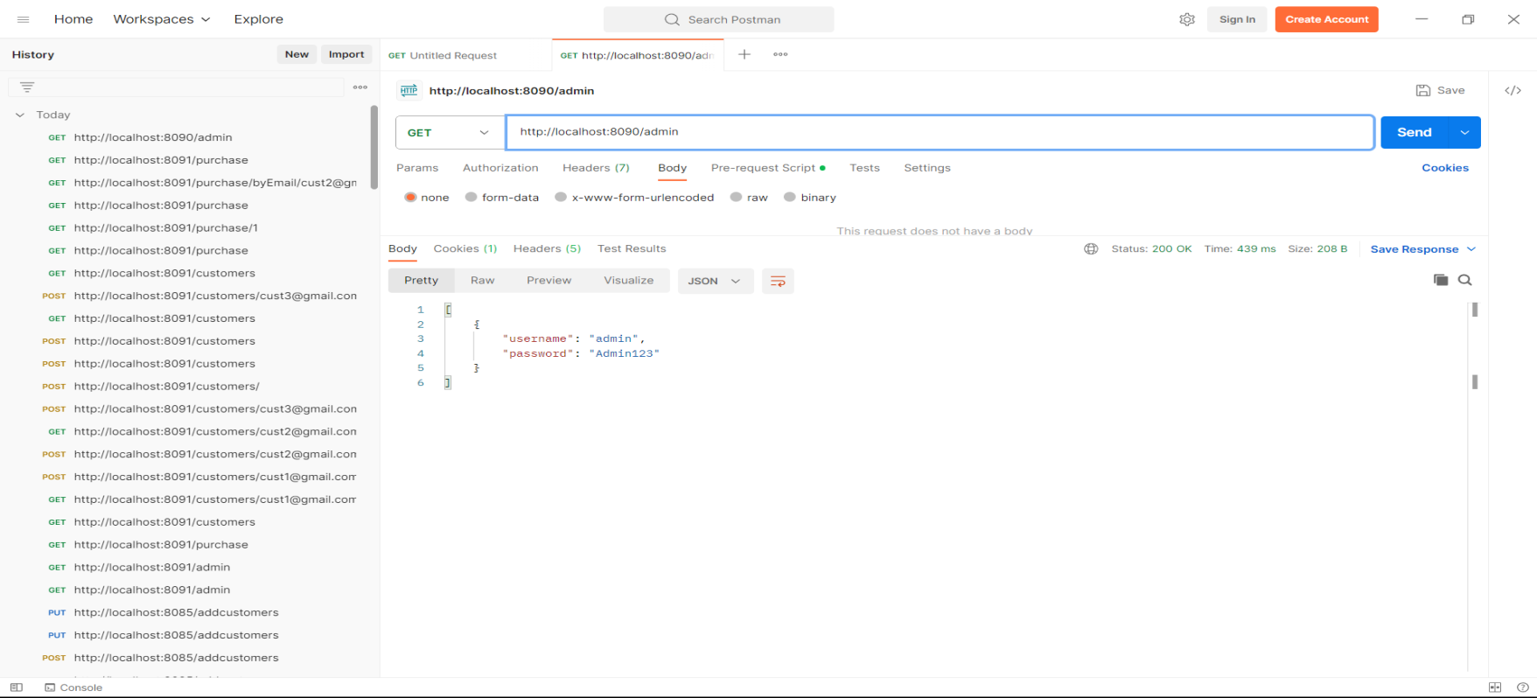
GET ADMIN

Slide 26
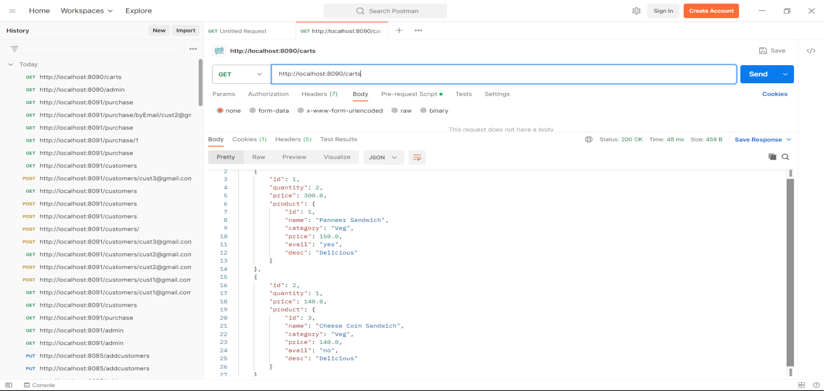
GET CARTS

Slide 27
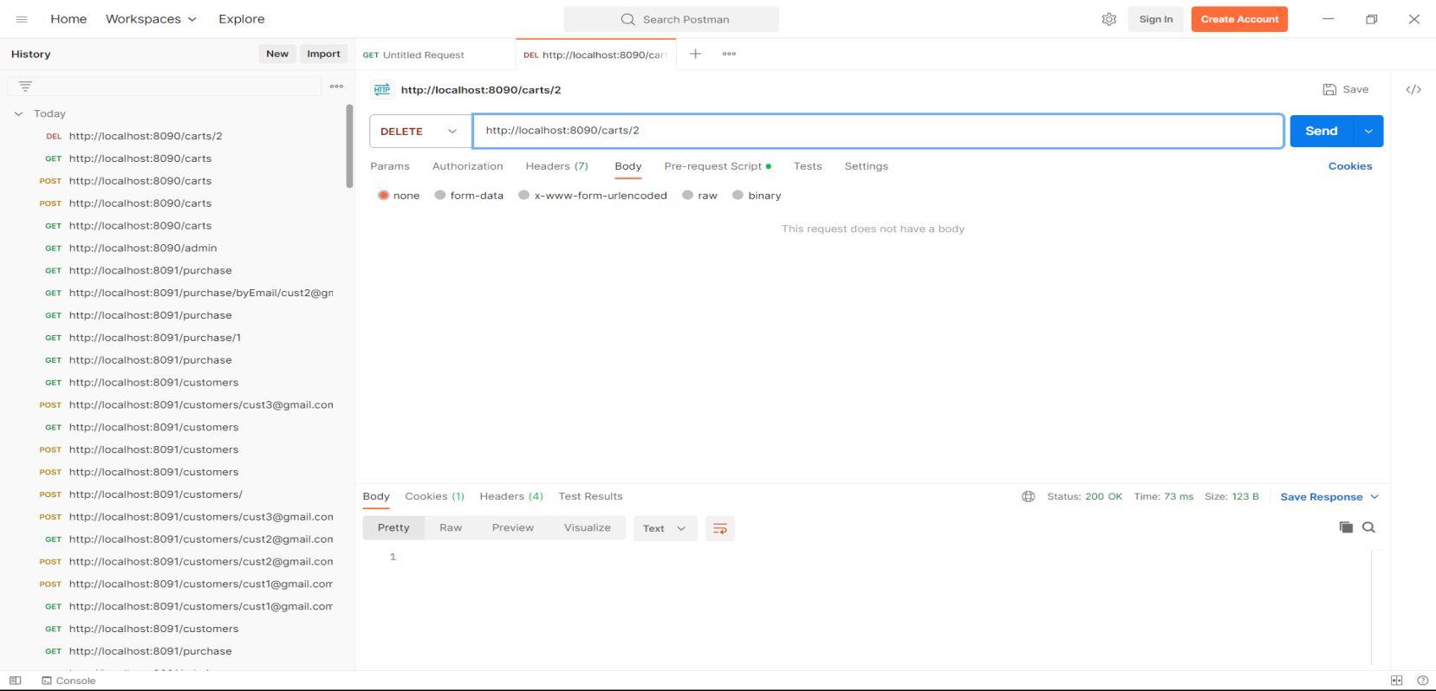
DELETE CARTS BY ID

Slide 28
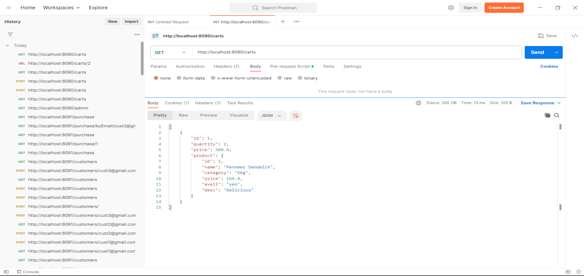
AFTER DELETE GET CARTS

Slide 29
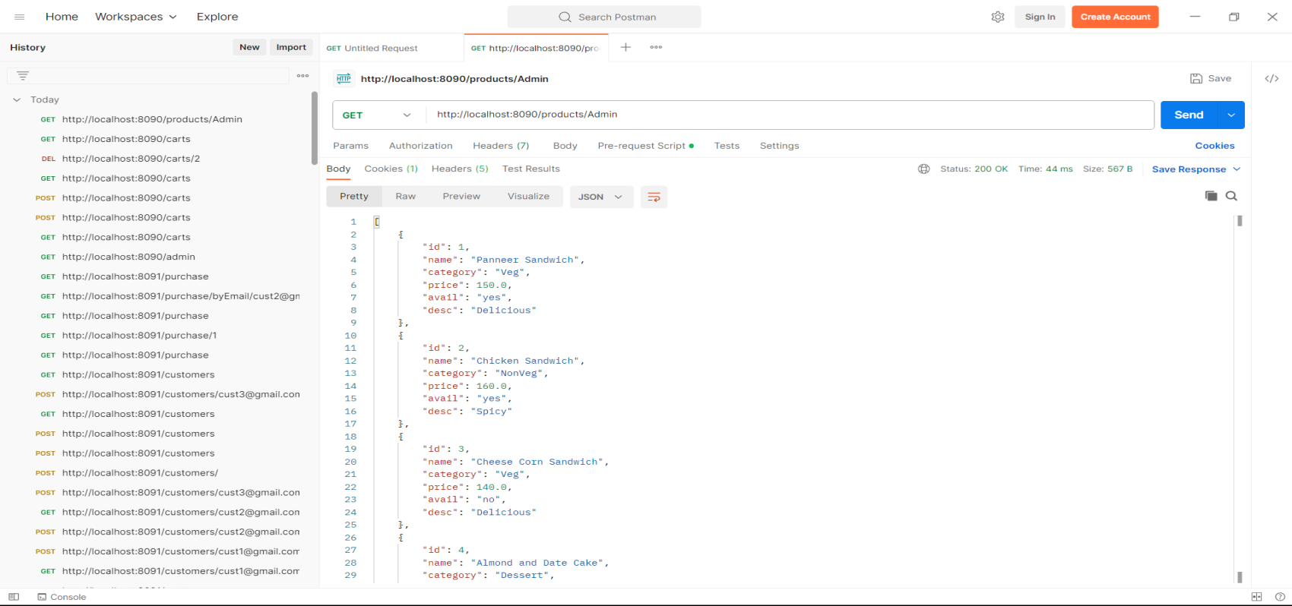
GET PRODUCT BY ADMIN

Slide 30

GET PRODUCT BY CUST

Slide 31
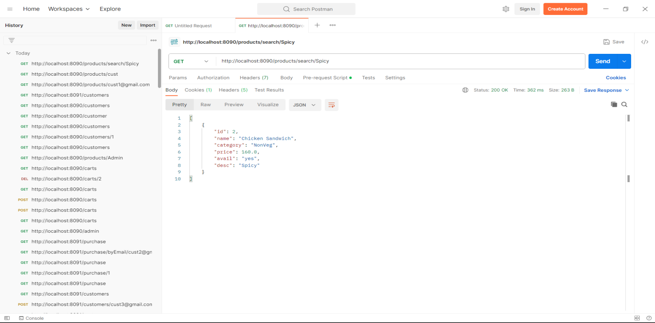
GET PRODUCT BY SERACH/KEYWORD

Slide 32
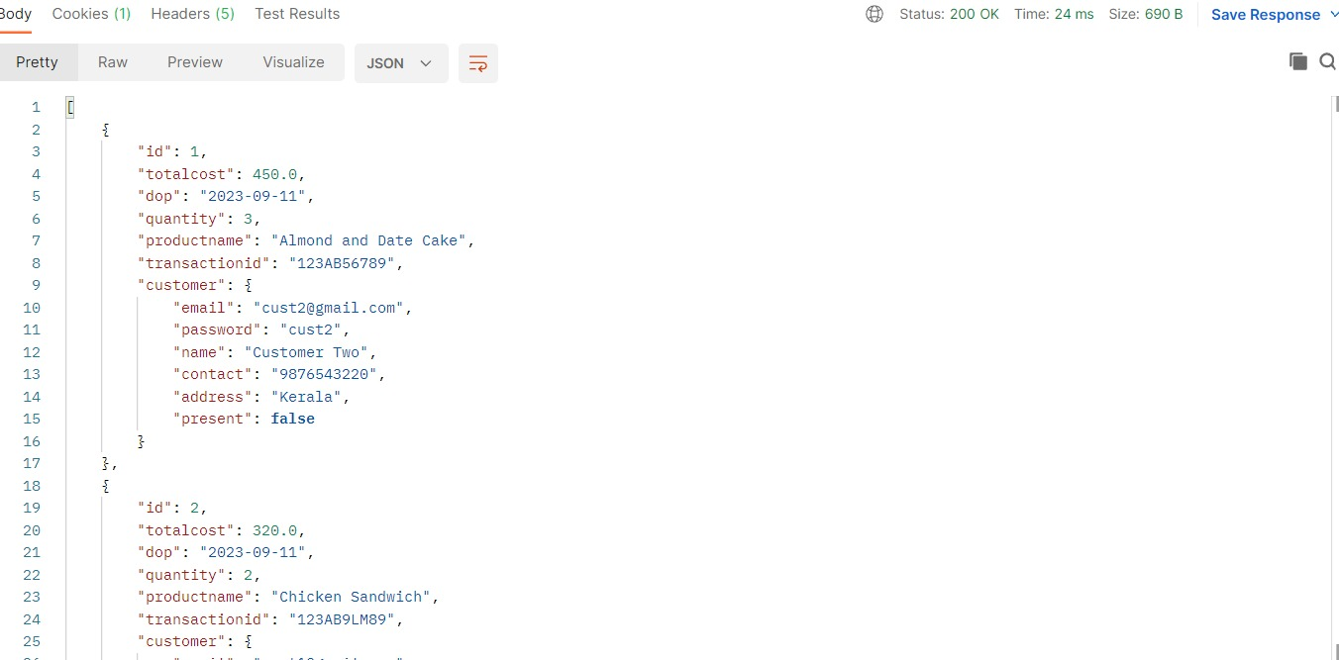
GET PURCHASE

Slide 33
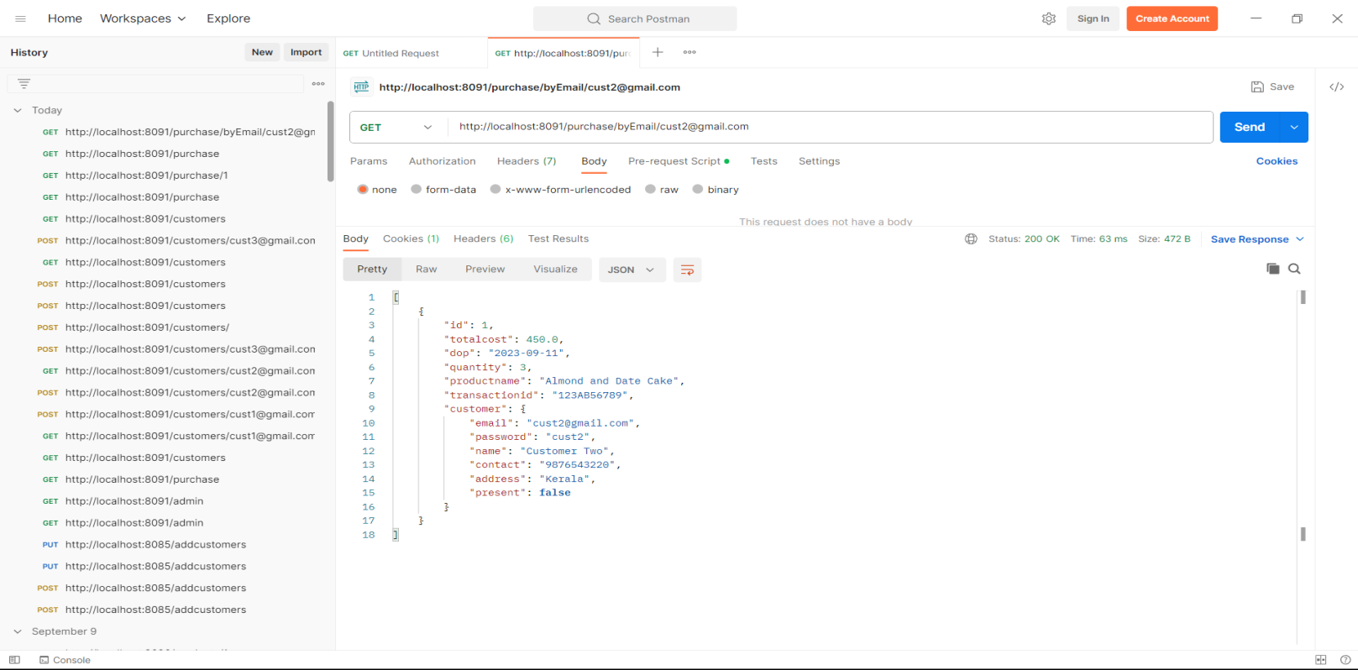
GET PURCHASE BY EMAIL/ID

Slide 34
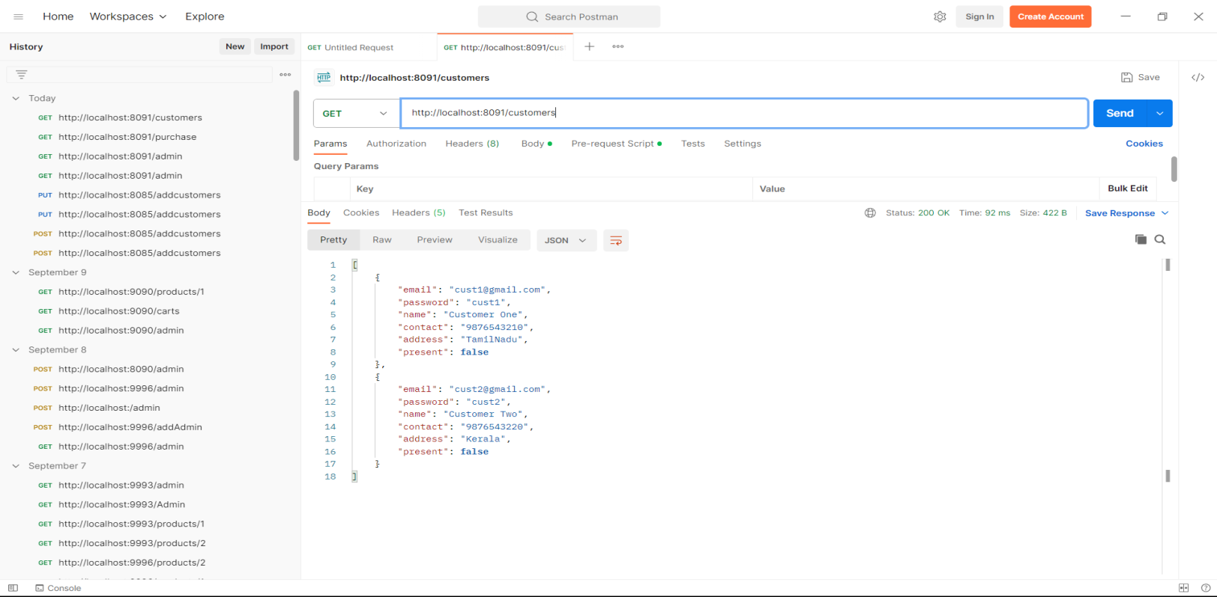
GET CUSTOMERS

Slide 35
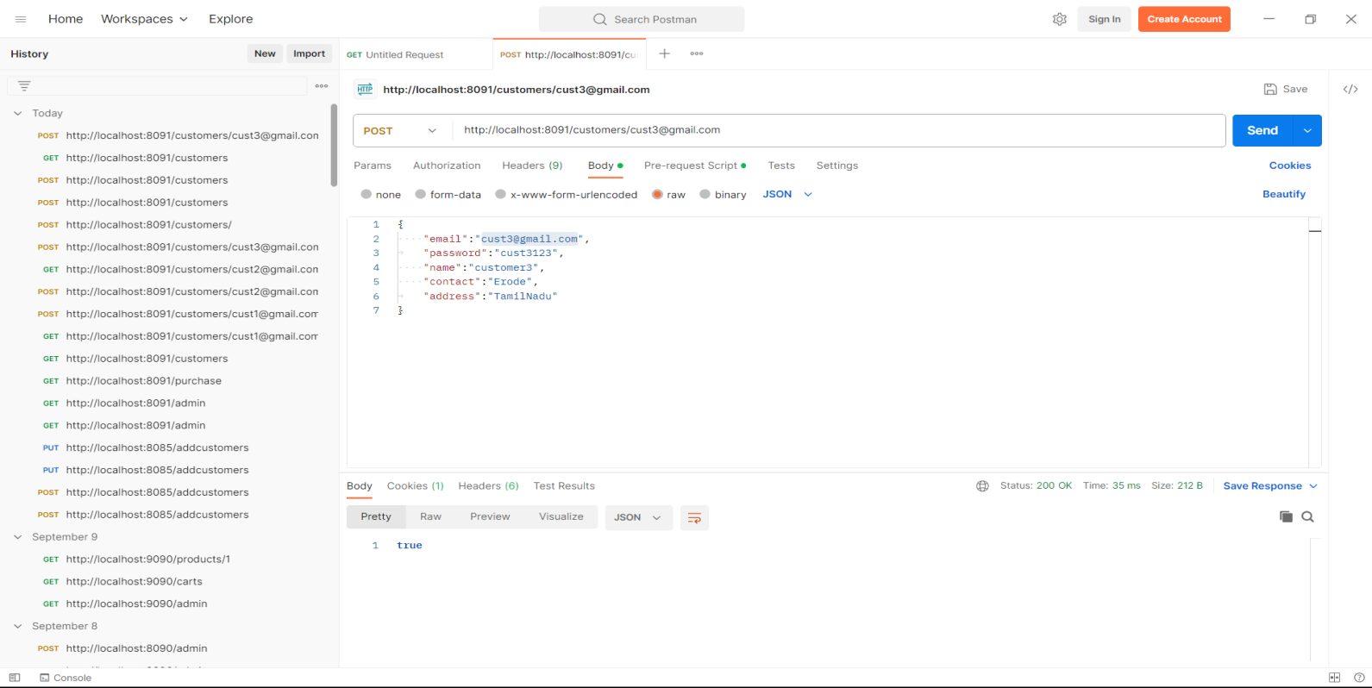
POST CUSTOMER BY EMAIL

Slide 36
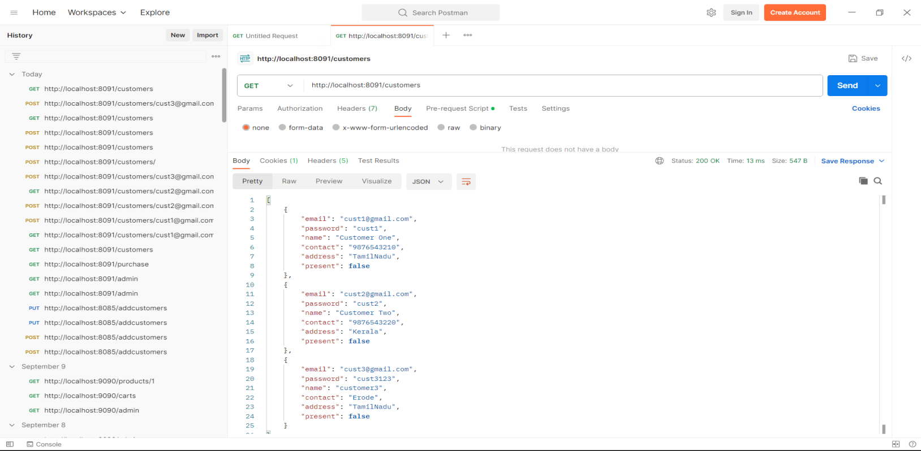
AFTER ADDING GET CUSTOMERS

Slide 37
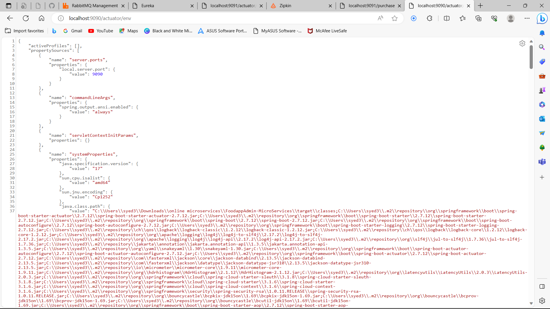
ACTUATOR

Slide 38
EUREKA SERVER

Slide 39
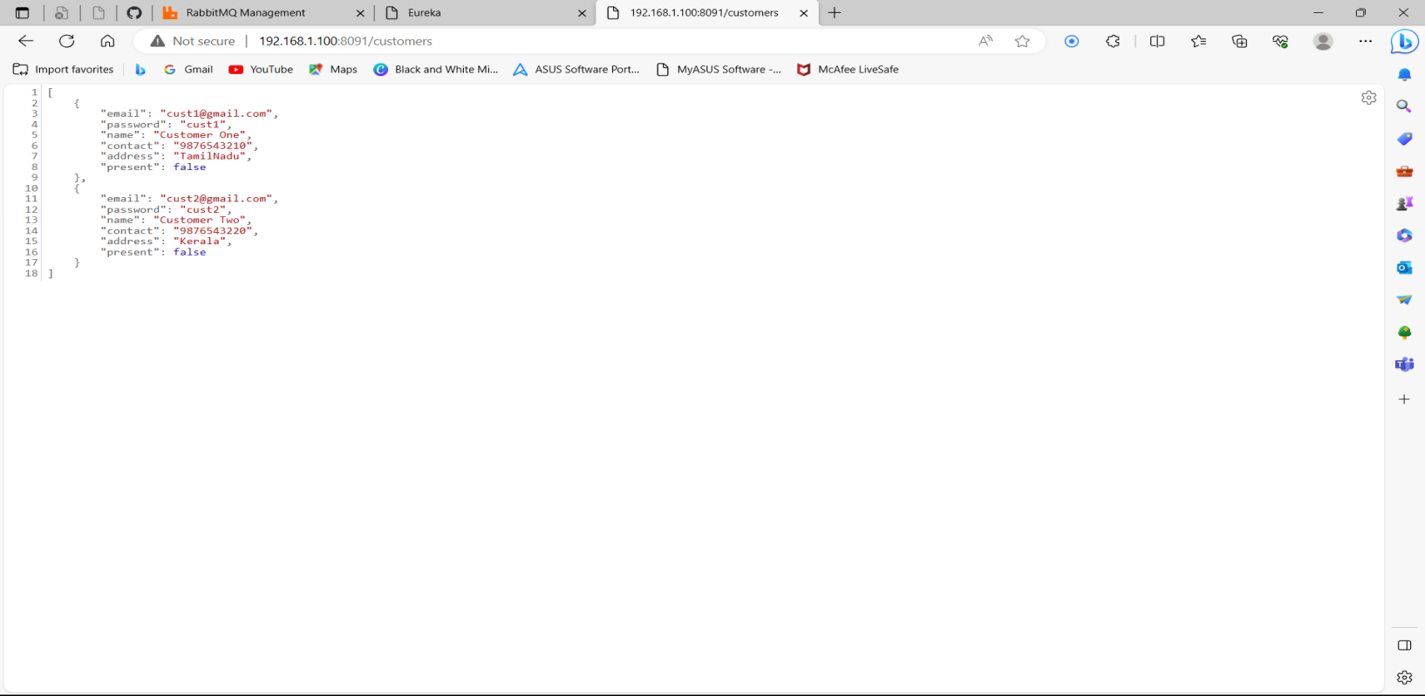
VIEW CUSTOMER SERVICE

Slide 40
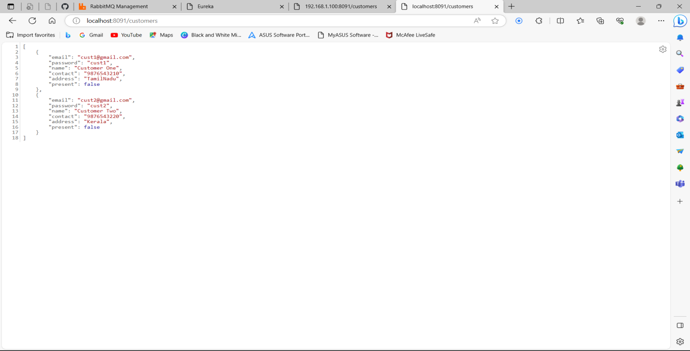
CUSTOMERS

Slide 41
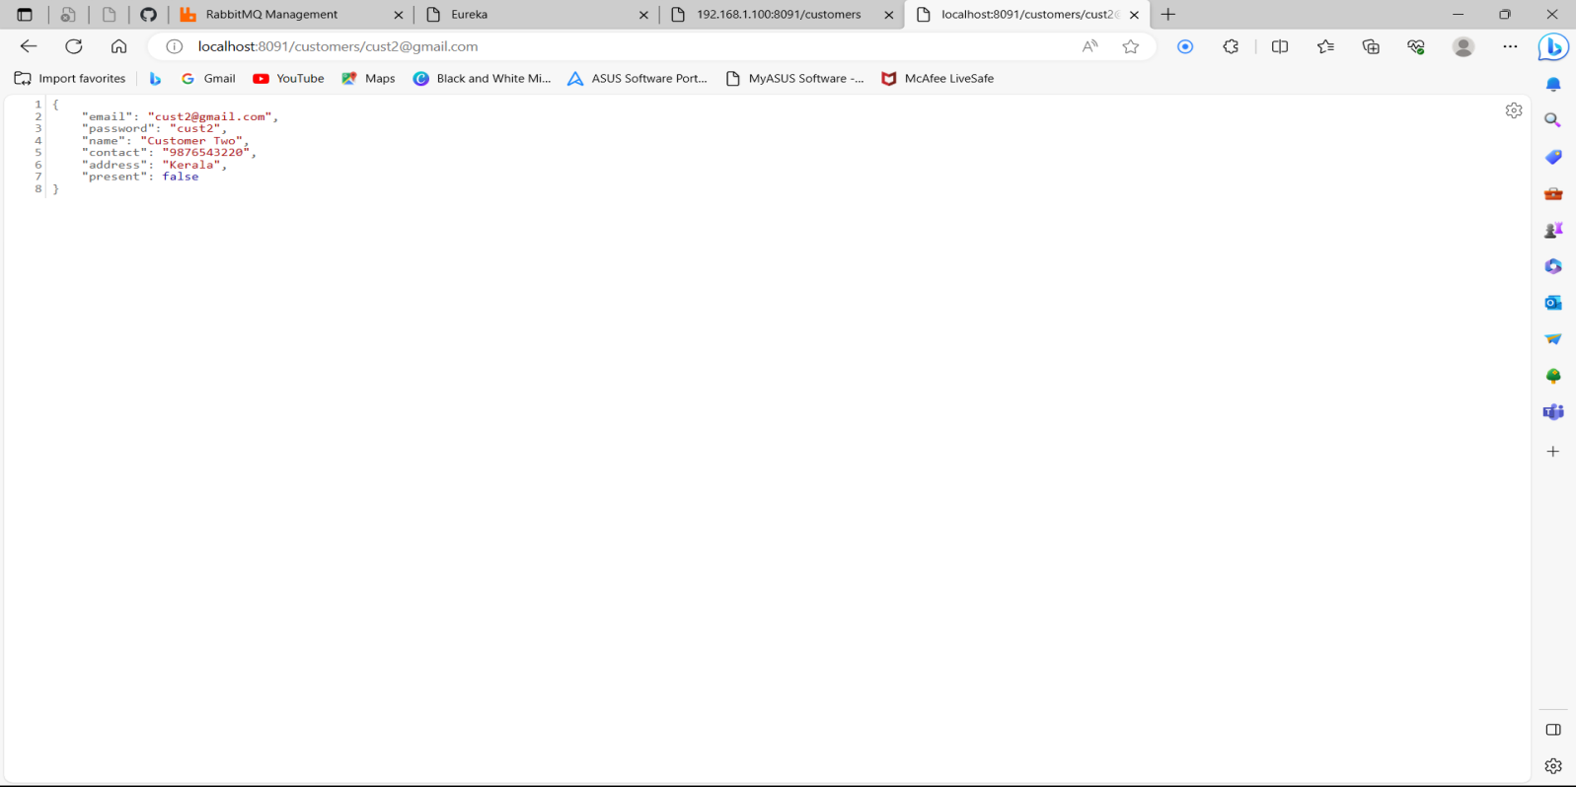
CUSTOMER/BY ID

Slide 42
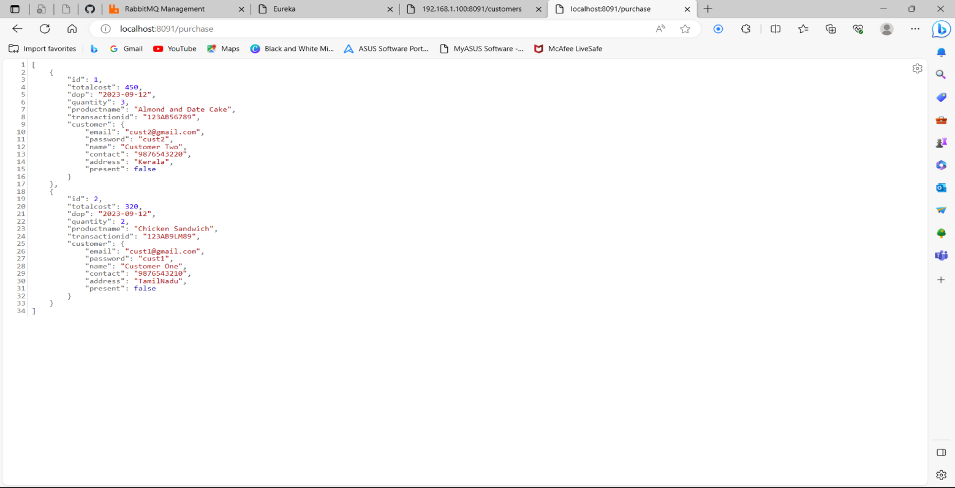
PURCHASE

Slide 43
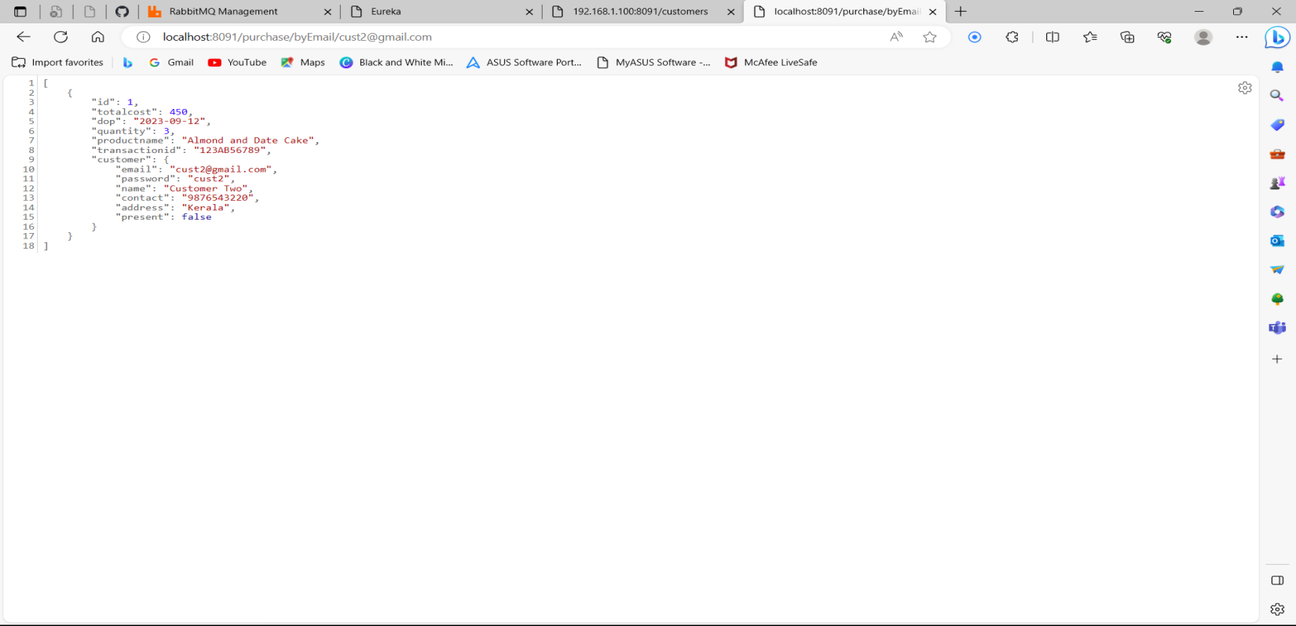
PURCHASE BY EMAIL/ID

Slide 44
EUREKA SERVER

Slide 45
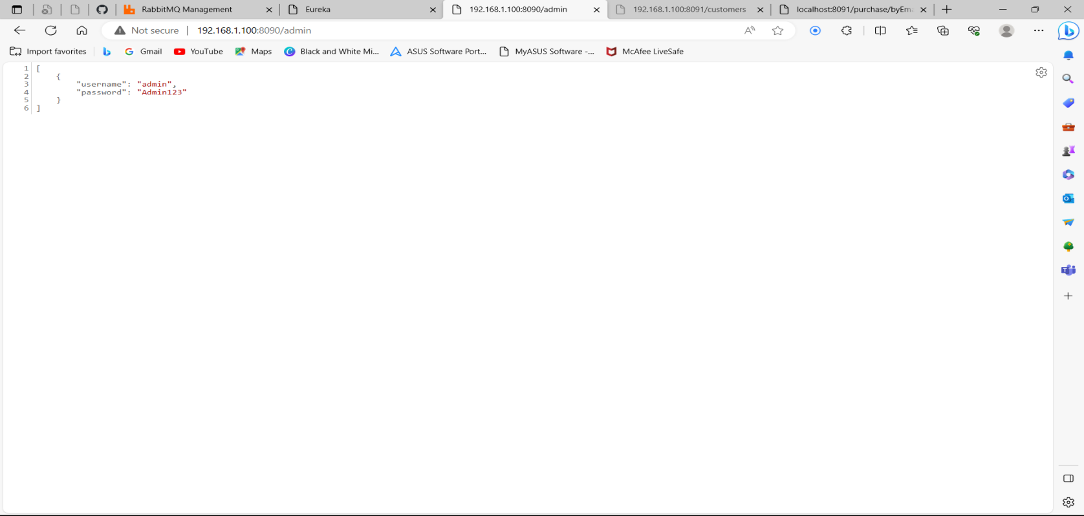
VIEW ADMIN SERVICE

Slide 46
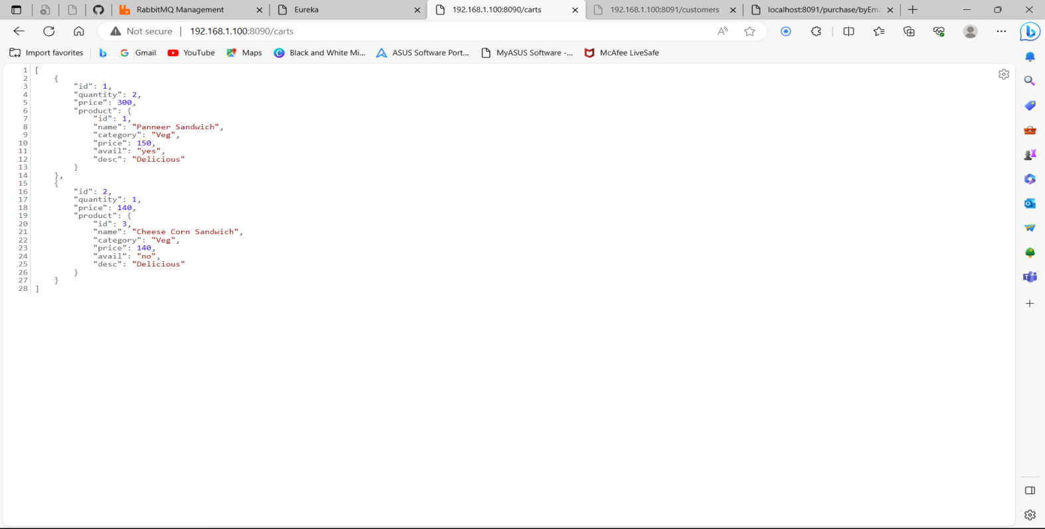
CARTS SERVICE

Slide 47
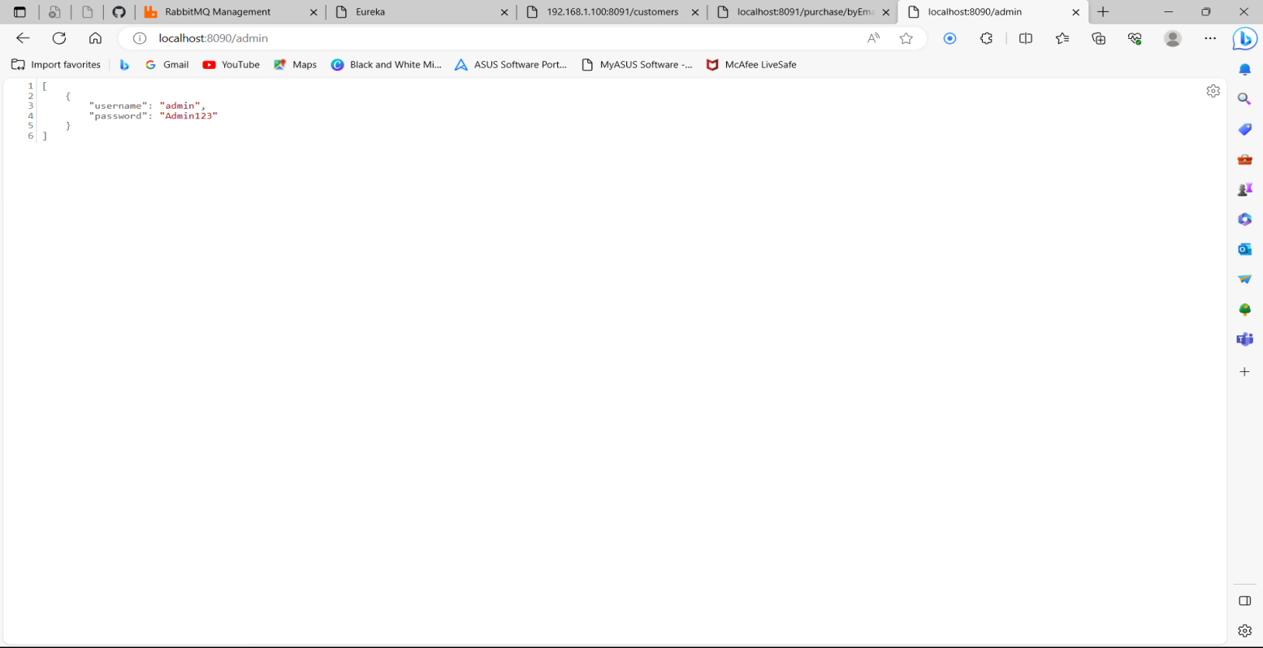
ADMIN

Slide 48
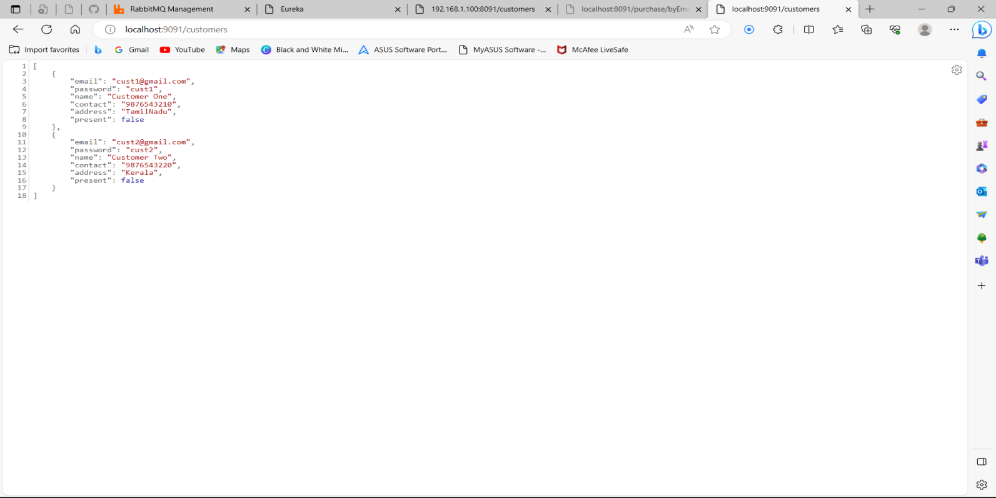
CUSTOMERS

Slide 49
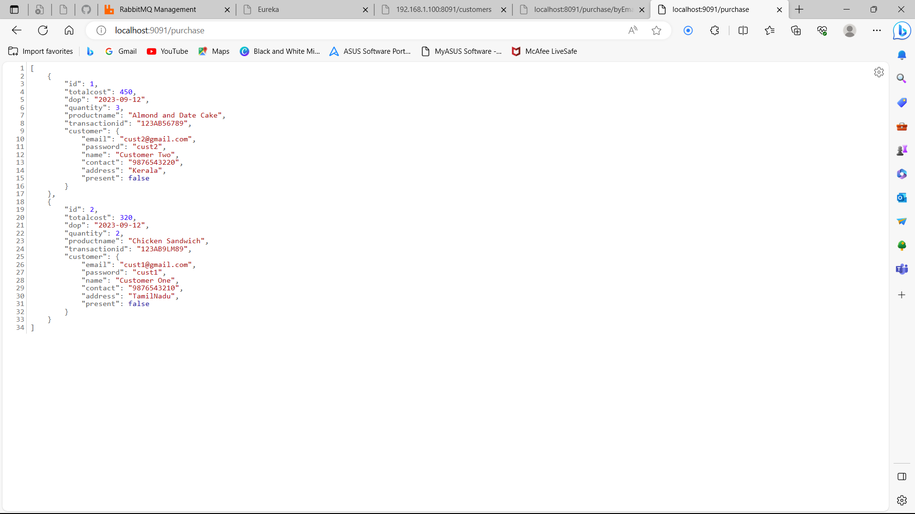
PURCHASE

Slide 50
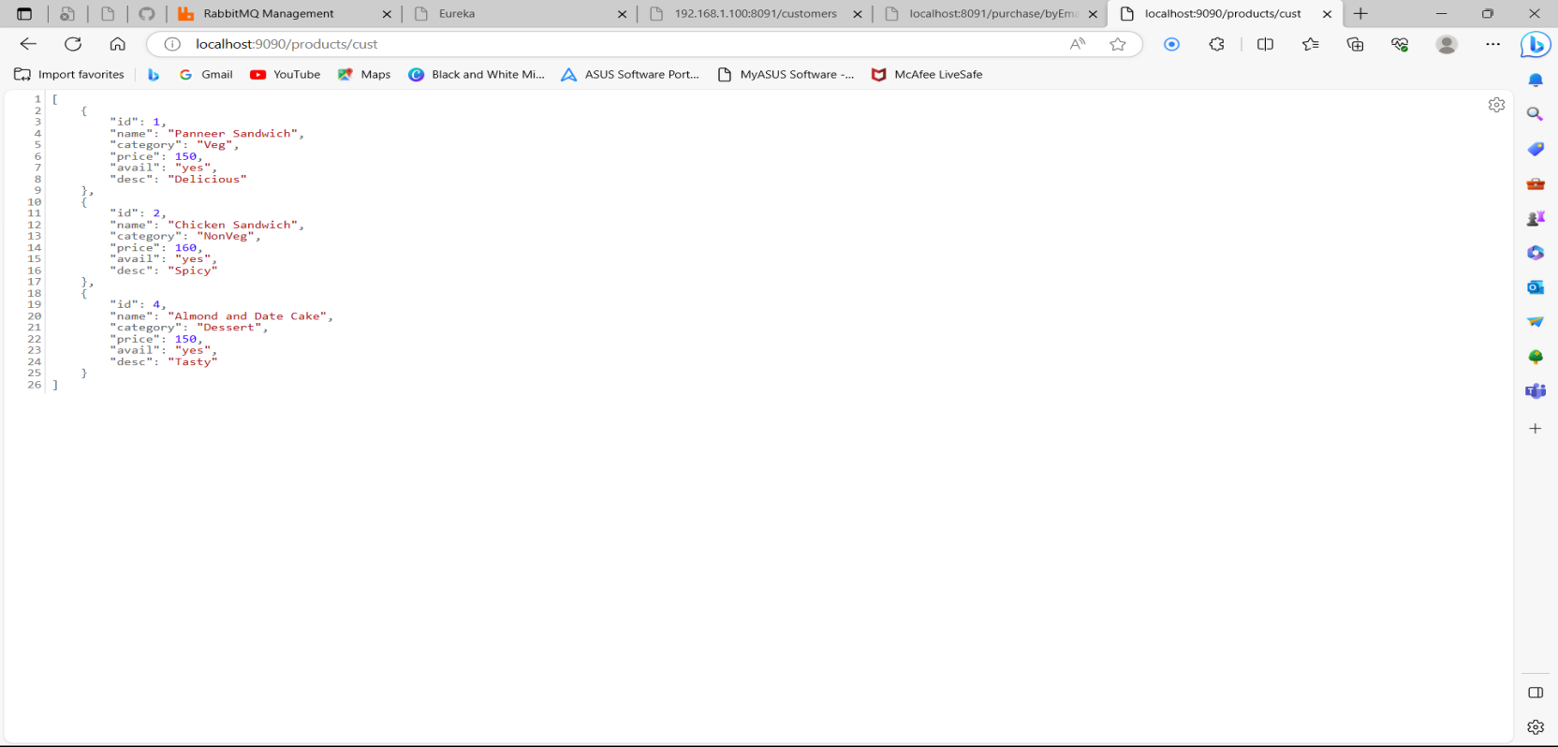
PRODUCTS/CUST

Slide 51
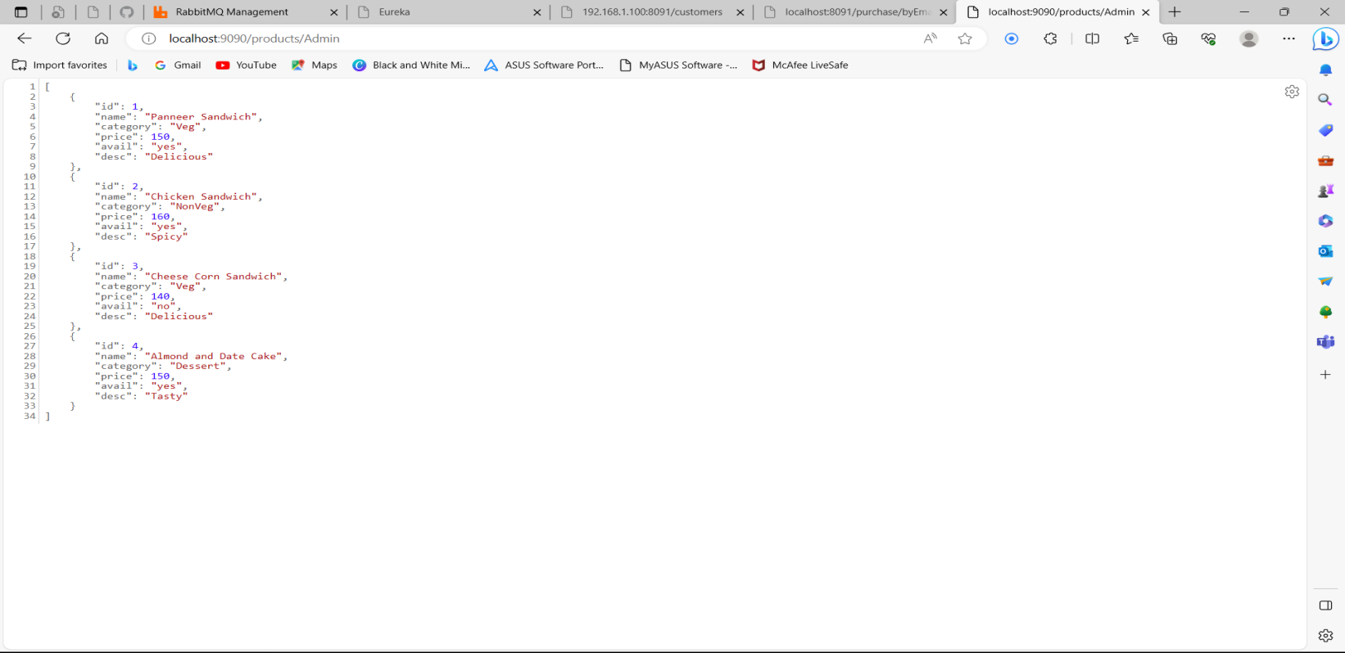
PRODUCTS/ADMIN

Slide 52
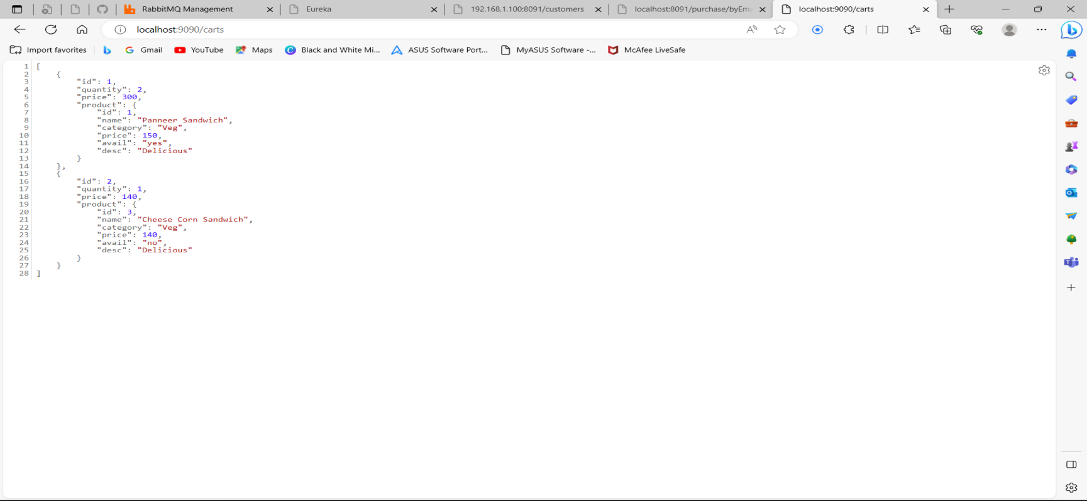
CARTS

Slide 53
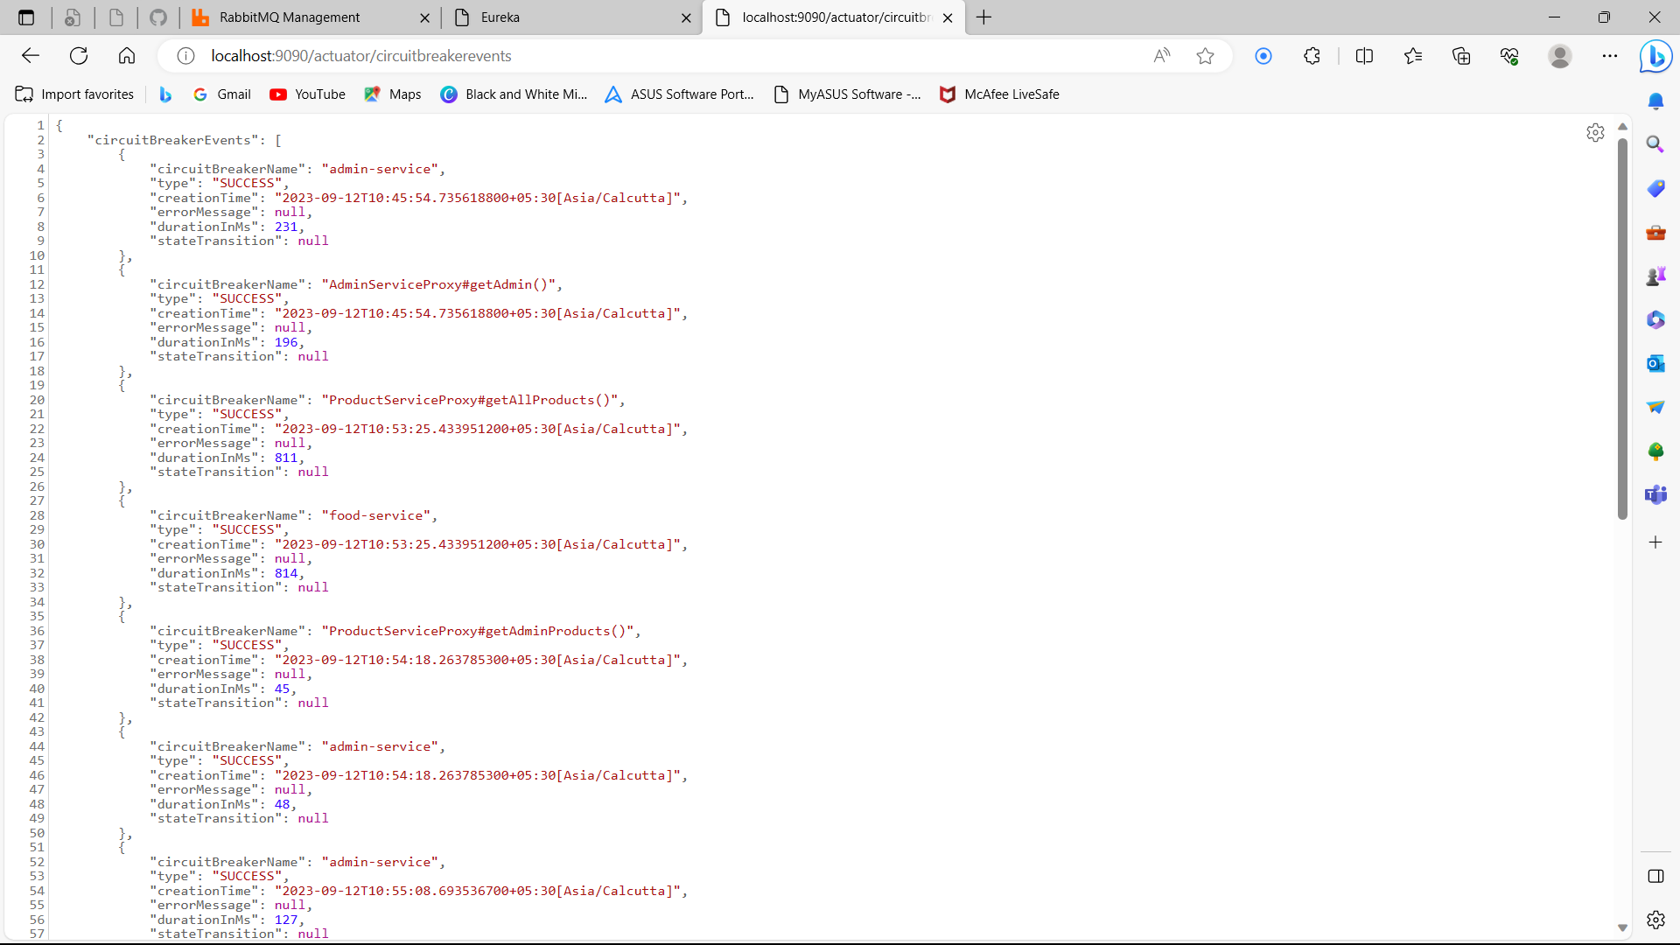
ADMIN MICROSERVICES CIRCUITBREAKER

Slide 54
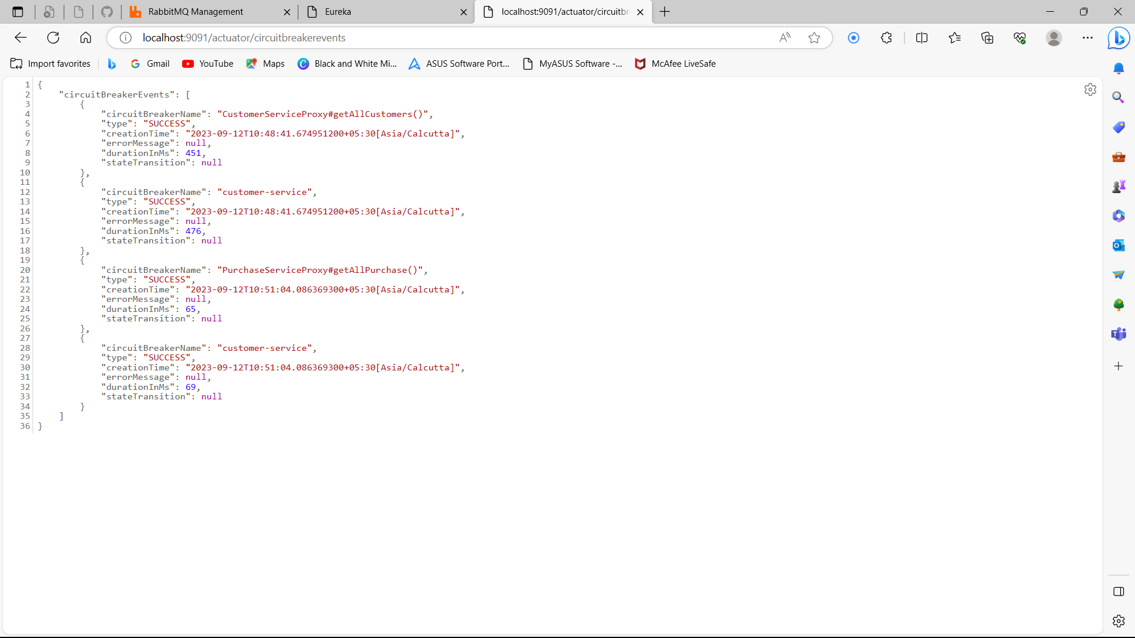
CUSTOMER MICROSERVICES CIRCUITBREAKER

Slide 55
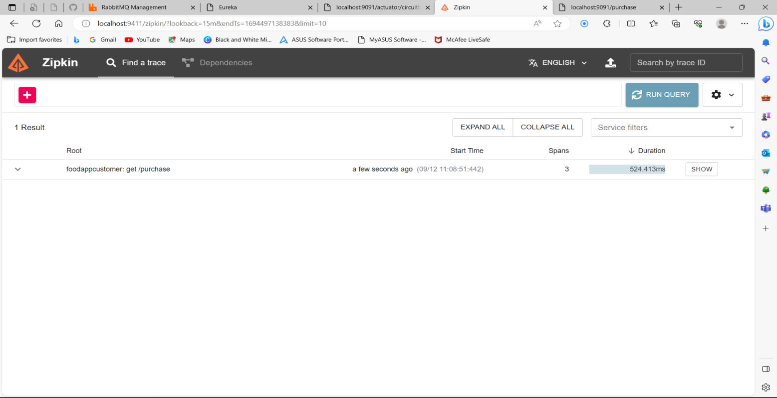
RUN QUERY

Slide 56
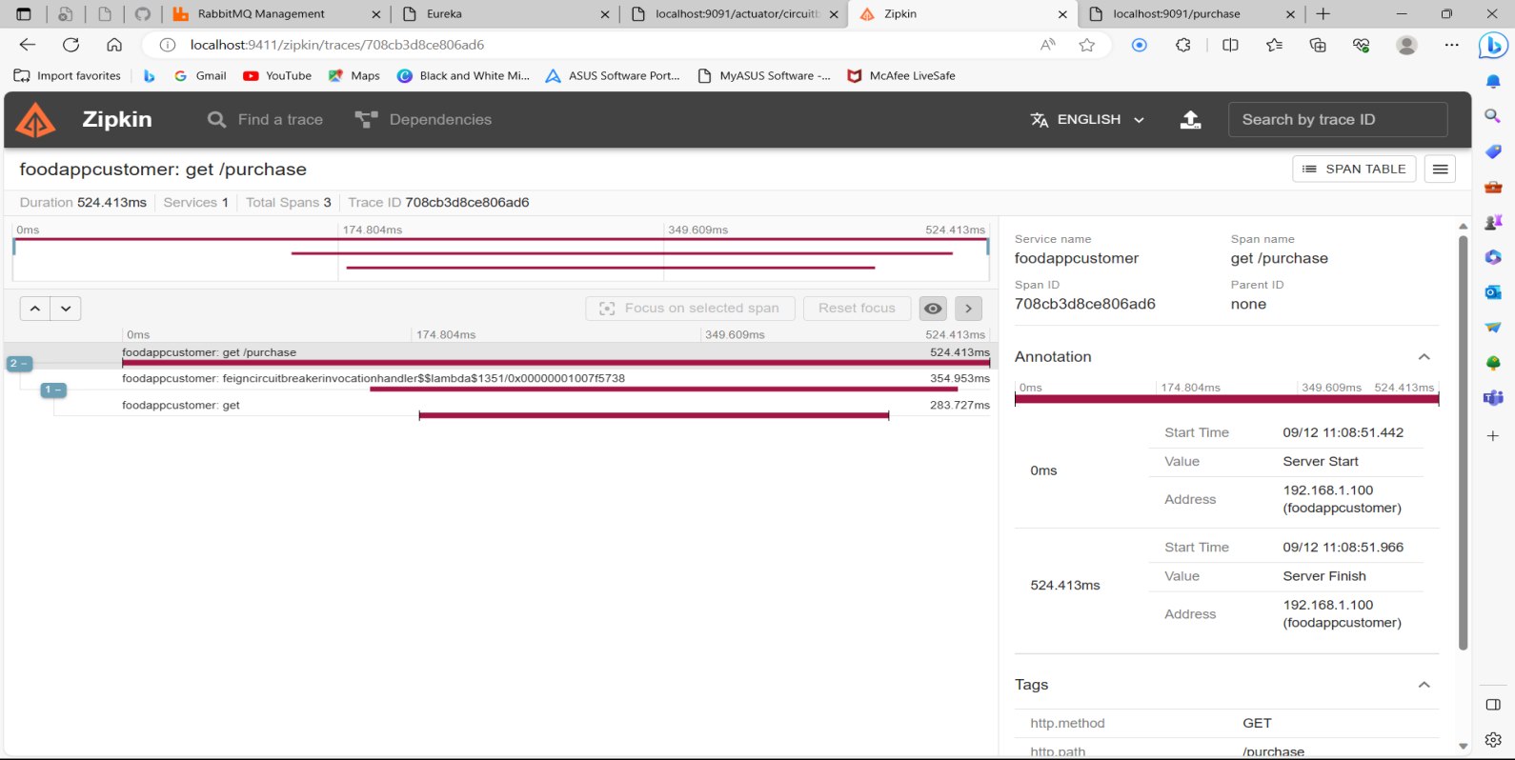
CHECKING SPAN ID

Slide 57
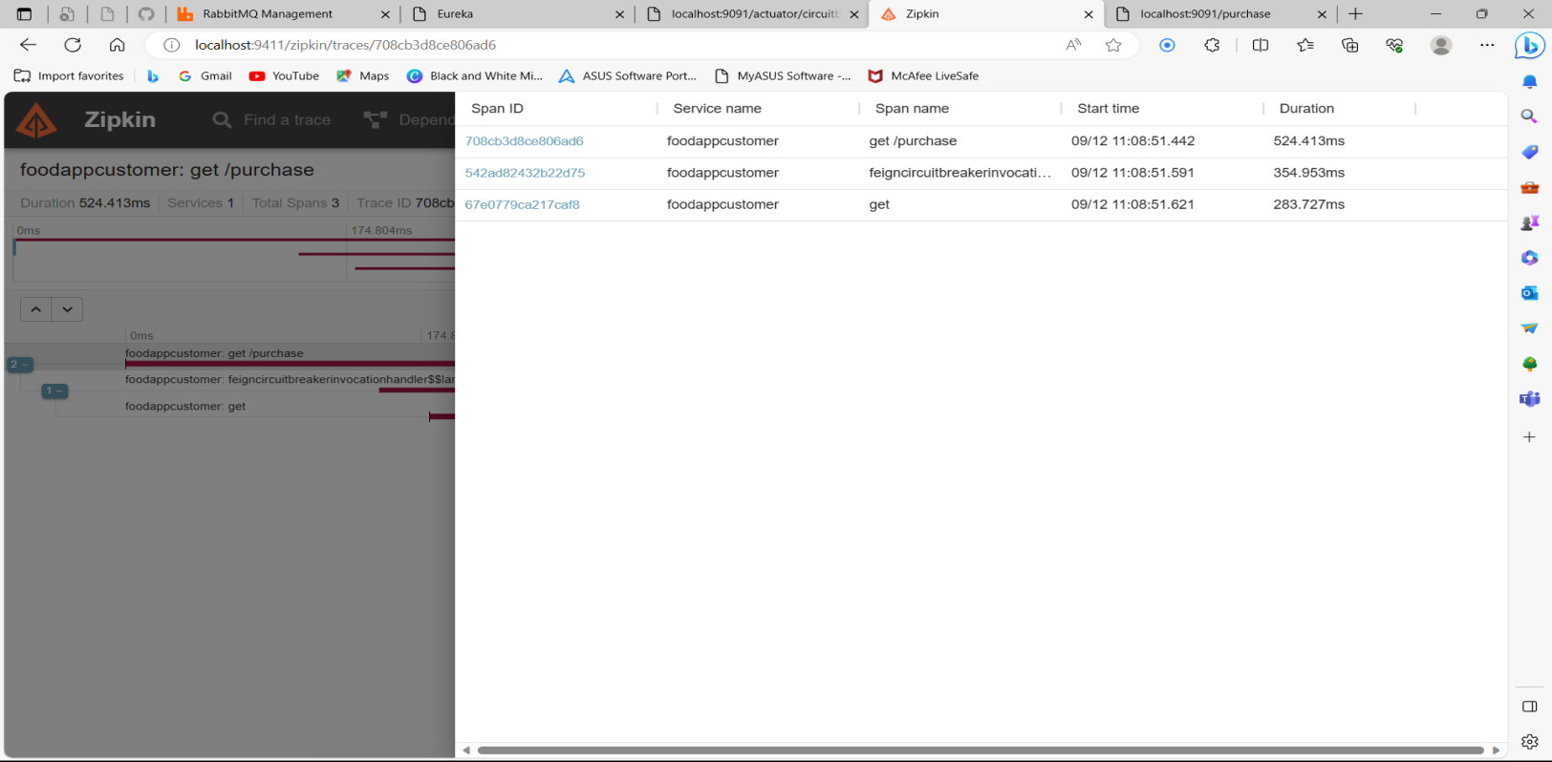
SPAN TABLE

Slide 58
CONCLUSION
Finally, for the online meal ordering system, we created a secure, user-friendly food ordering administration system.
Whether they are Administrators or Customers, this system can look after them all.
This system will let them manage client meals, delivery boy data, and expand without creating any disruption.
This system is completely secure because each user is assigned a unique user ID and password, preventing Un authorised access.
It is significantly simpler to use with online registration, payment, and cancellation.
As a result, employing this method will reduce labor costs while increasing the amount of time clients can spend taking use of the services.

Slide 59


